Slide 1
Catch the Pollution
Appendix J
What is air pollution?
Adapted by Jeness L. Vignoe, George Mason University, Virginia, 2011

Slide 2
What is air pollution?
Let’s look at our pollution catchers.
All that dirt and pollution in the air makes things outside dirty and can make it difficult to breathe.
Adapted by Jeness L. Vignoe, George Mason University, Virginia, 2011

Slide 3
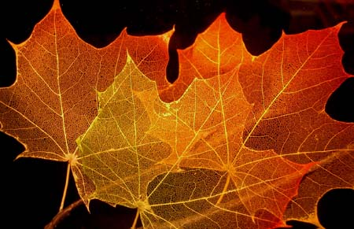
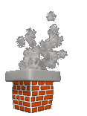
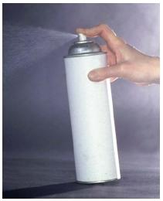
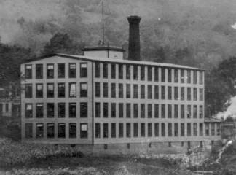
Where does air pollution come from?
Air pollution comes from a lot of places:
Cars
Factories
Leaves burning
Smoke from chimneys
Aerosols
Chemicals
Adapted by Jeness L. Vignoe, George Mason University, Virginia, 2011

Slide 4
Why is it harmful to us?
Air pollution can go deep into our bodies and can be very harmful to us.
That’s why it is so important to do what we can to help stop air pollution from spreading.
We want to stay healthy!
Adapted by Jeness L. Vignoe, George Mason University, Virginia, 2011

Slide 5
What can YOU do?
YOU can make a difference in the battle against pollution.
Reuse, Reduce, and Recycle!
Reduce the amount of trash you throw away
Try to reuse items
Recycle items
Adapted by Jeness L. Vignoe, George Mason University, Virginia, 2011

Slide 6
References
Information for this PowerPoint was found from:
Wisconsin Department of Natural Resources
Bureau of Communication and Education.
(2004). Clean air, healthy children: Teacher’s
guide and activities for young children.
Retrieved from dnr.wi.gov/air/pdf/CAHC.pdf

